Slide 1
Digital Family Histories
Team 1
Aditya Joshi (ajoshi6)
Amber Raza (araza3)
Abhishek Arya (aarya)
Darpan Dodiya (dpdodiya)
Neeraj Deshpande (ndeshpa)
Karthikeyan Vaideswaran (kvaides)

Slide 2
Objective
Design a digital family health history application that is:
User-friendly and easy to use
Capture all essential health data
Focusing on younger and typically healthy individuals (14 - 40 years)
Accessible to the population with low literacy

Slide 3
Background
What is family health history ?
Family history is not usable if it doesn't have all information.
It is patient-generated health data.
Challenge: get the users to fill data as accurately as possible.
Beneficial to all: Insurance, care providers, patients

Slide 4
Workflow
Patient encounter.
Clinician provisions MeTree account.
Patient accesses and fills out information.
Generate a personalised risk profile and a corresponding family tree.
Patient and clinician collaborate on patient's MeTree report

Slide 5


Slide 6
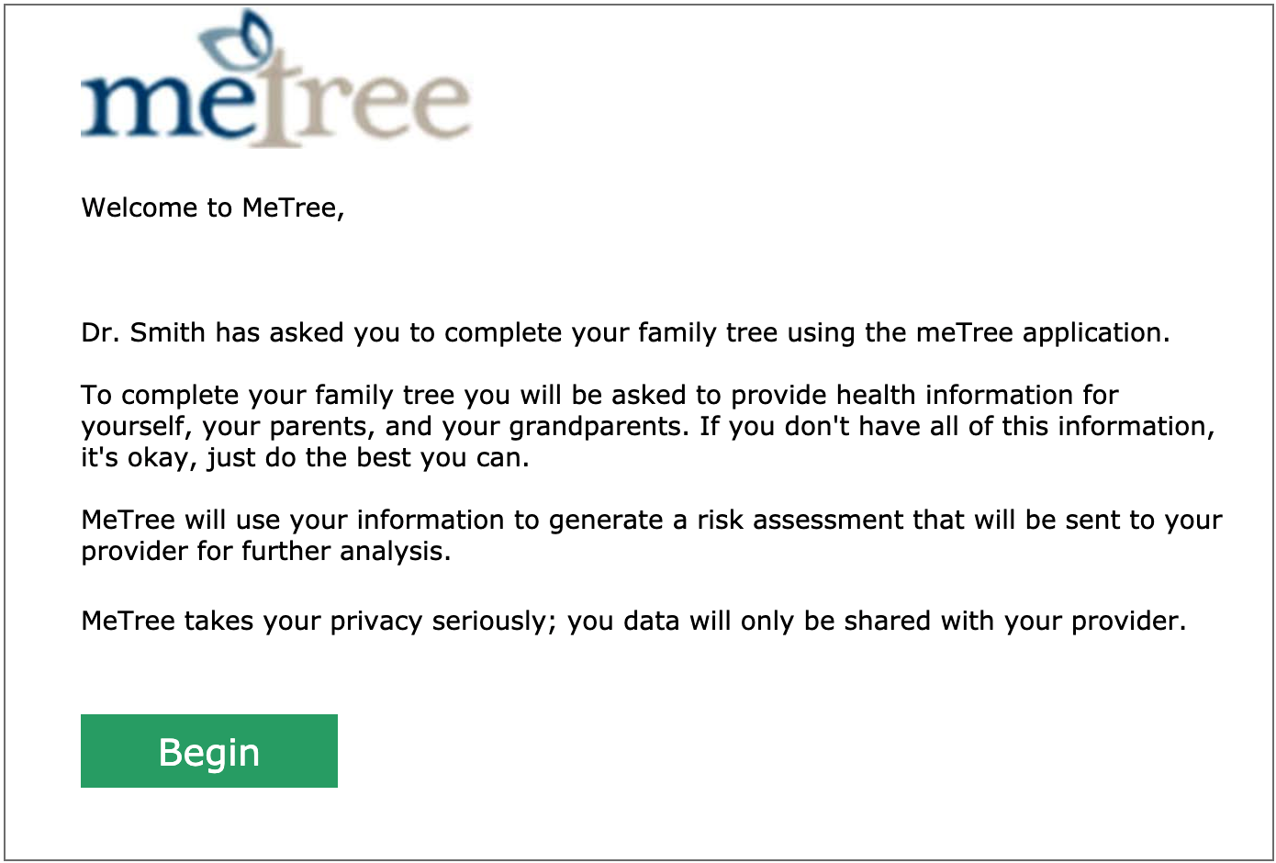
Invitation
User receives an email from doctor to create an account on MeTree.

Slide 7
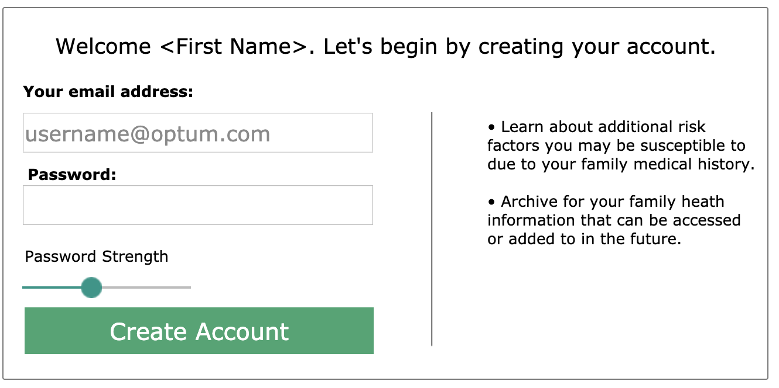
Signup
Username is the email address of the user which is prefilled.
User has to just choose password to create account.
Notes:
And uneditable.

Slide 8
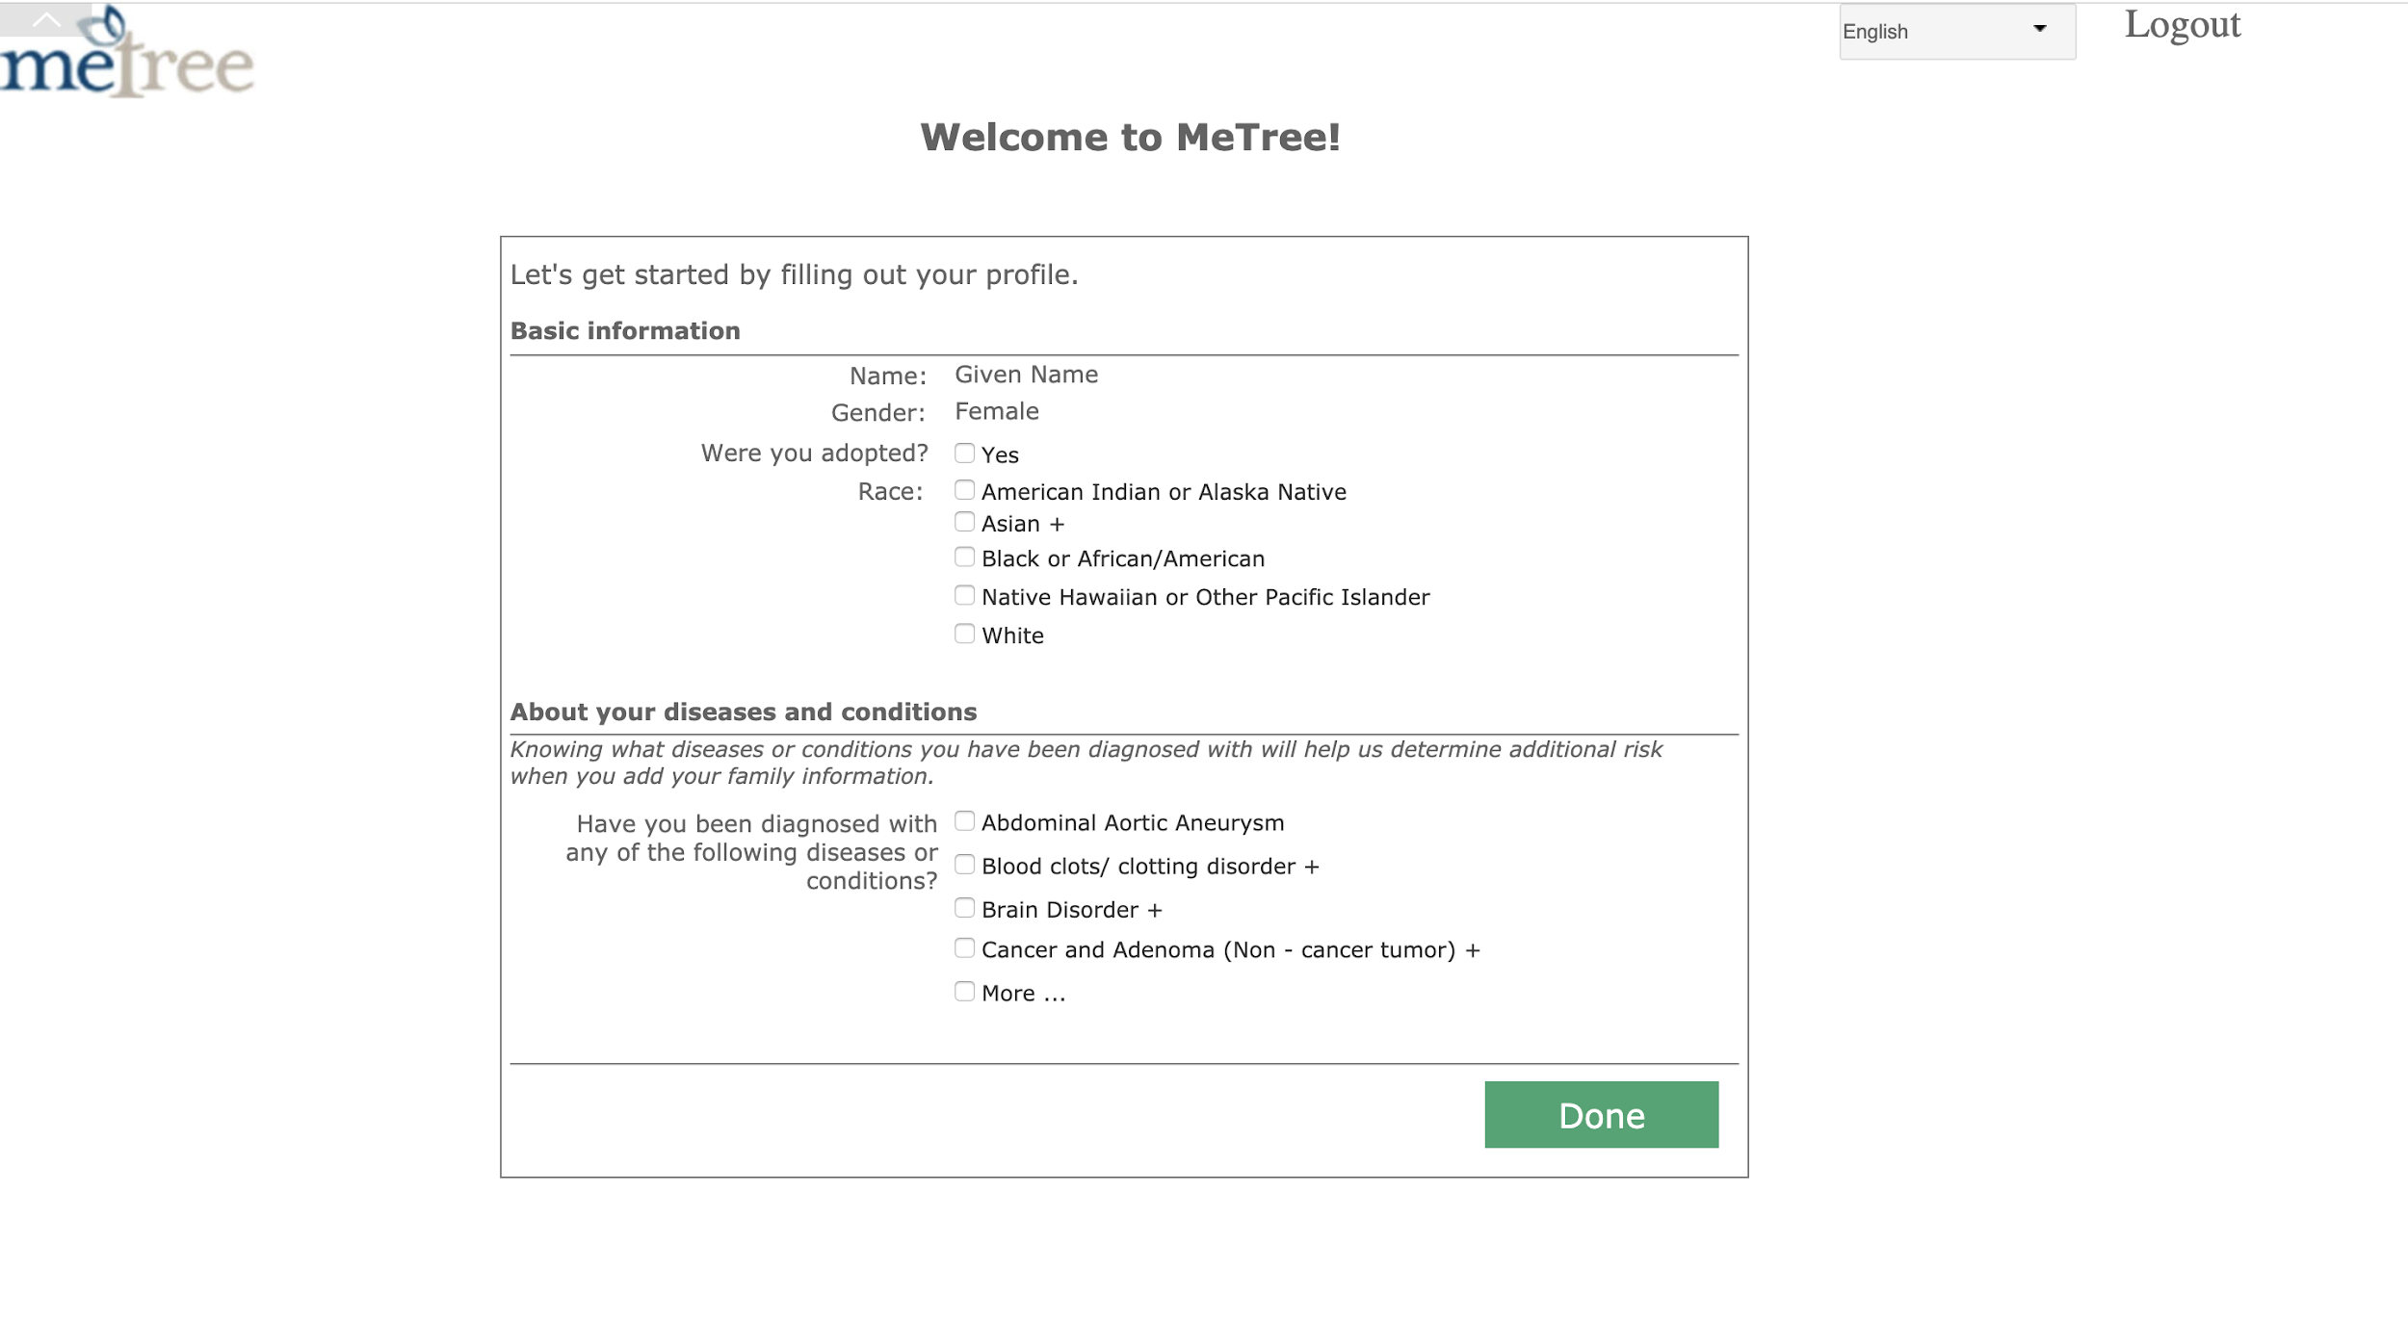
Basic Information
The user fills out his/her basic and health related information.
Notes:
Name and gender are prefilled. If checked on ‘Were you adopted’, then family info is not asked to filled.

Slide 9
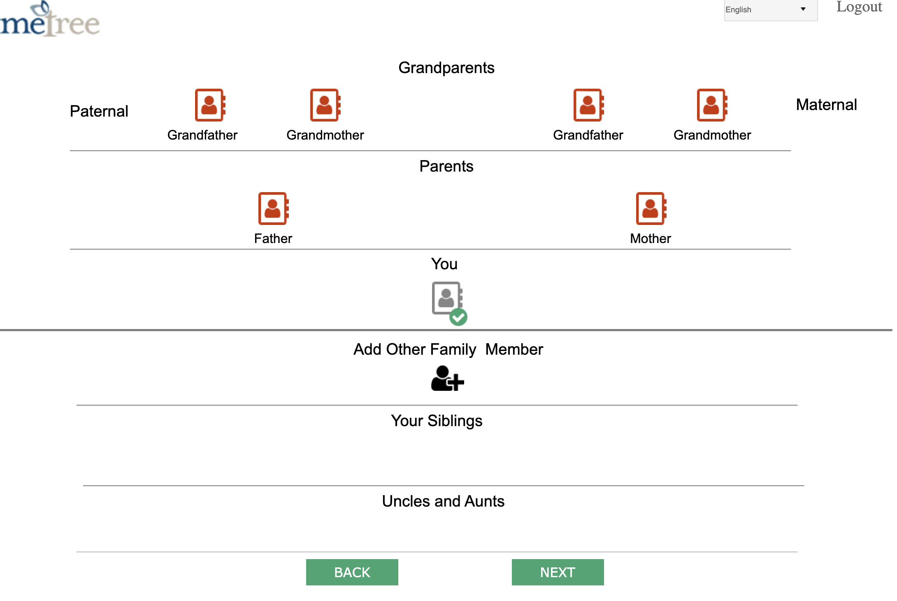
Family Information
The user can view the status for each family member and select the family member whose information needs to be filled.

Slide 10
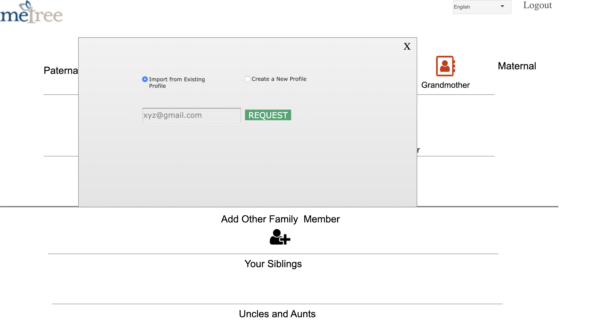
Family Information (contd.)
User can either import information from an existing account or create a new profile for the family member.

Slide 11
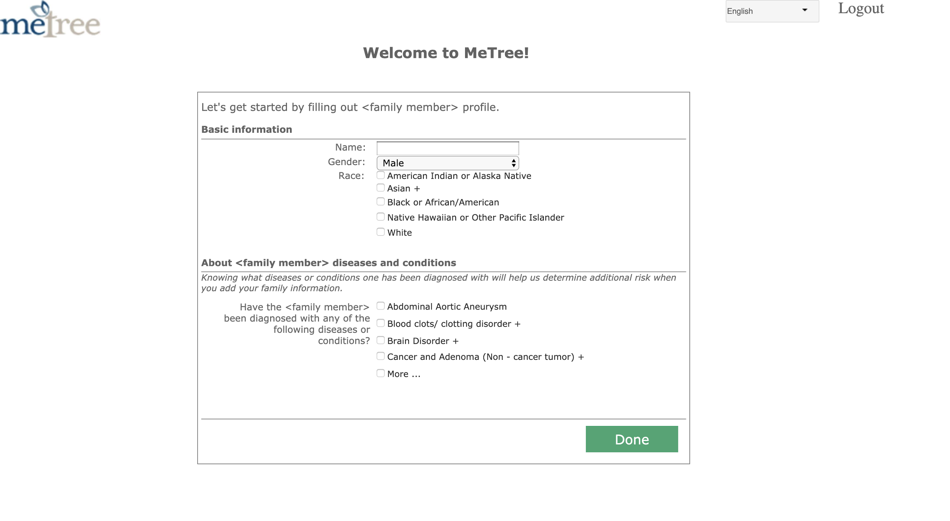
Family Information (contd.)
User fills out the information about the selected family member manually.

Slide 12
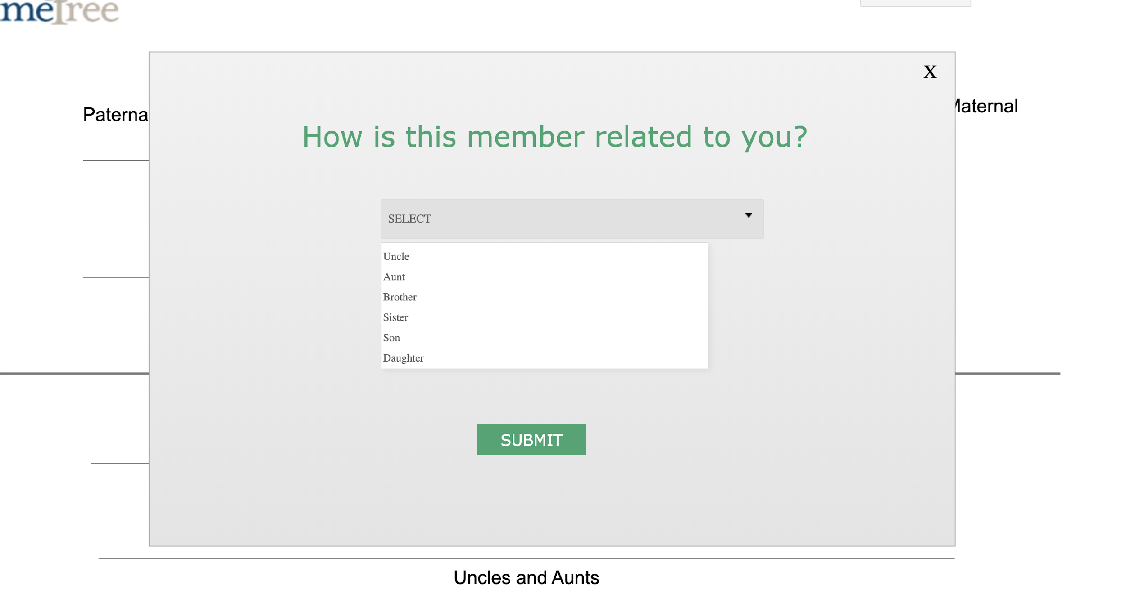
Family Information (contd.)
User can add other family members such as siblings, uncles, aunts etc.

Slide 13
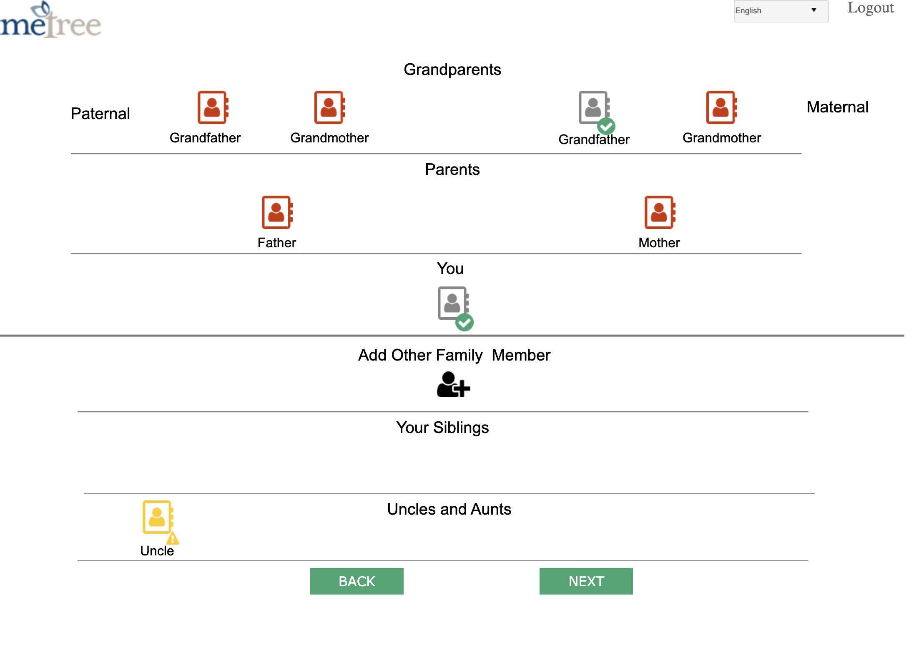
Application Progress
This page shows the status of information filled for each member including self.
Different icons used to indicate progress of each member.
Notes:
Explain the different legends -> red, yellow, green tick

Slide 14
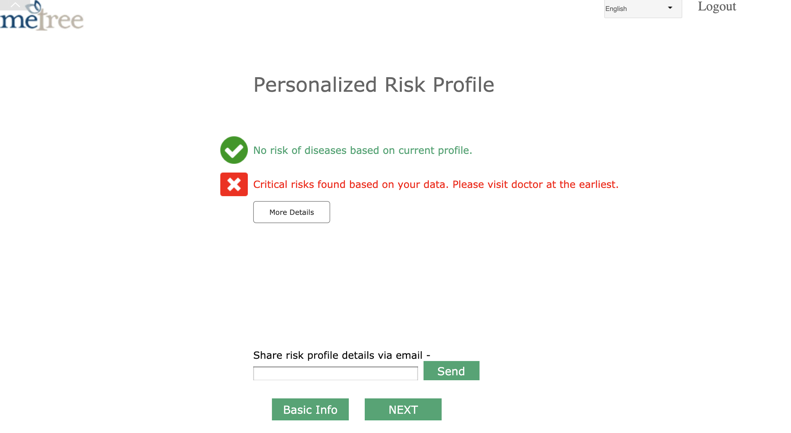
Result
User can view the risk profile and share it with the doctor via email.

Slide 15
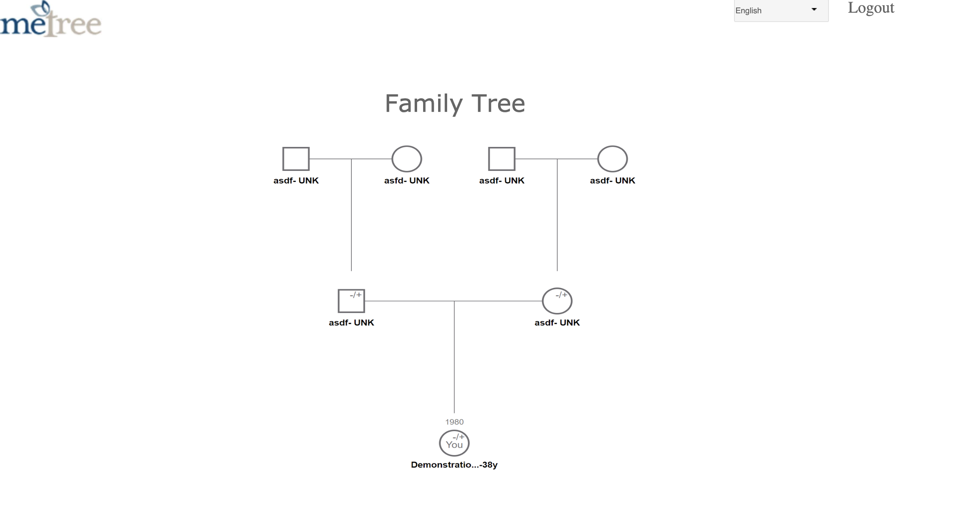
Result (contd.)
Based on the information provided, the family tree pedigree is generated and displayed.

Slide 16
Accomplishments
Reduced unnecessary input fields
Introduced new functionality to import profile
Revised flow to enter family members’ info easily
UI improvements
Notes:
Form easier to fill.

Slide 17
Questions
Thank you!

